Slide 1
Detection of Traffic Light Signals
Name : Jeevan S
Block : Susruta

Slide 2
Project architecture.
We have use Opensource TensorFlow object detection model “Resnet to detect traffic light box” .
We extract the traffic light box from the input.
We have created a simple CNN to categorize the traffic light box image
Classes : Green , Red , Orange , No-signal

Slide 3
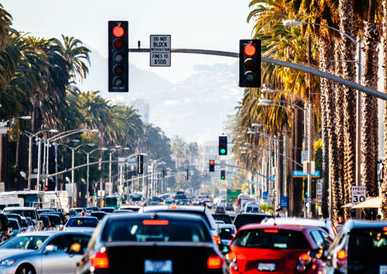
Result
The Resnet model predicted 7 traffic light boxes.
Below are two images which belongs to extracted traffic boxes.
The trained CNN model predicted correct label for the below two images.

Slide 4
Project details.
Due to limitation of hardware and Time we have low accuracy in categorizing the traffic lights .
We have taken ~700 images which are low quality from each category for training CNN model expect ‘not-traffic-light’ which only have 15 images.

Slide 5
Reference:
Training was done with Kaggle dataset . Link : https://www.kaggle.com/datasets/mbornoe/lisa-traffic-light-dataset
TensorFlow models : https://github.com/tensorflow/models/tree/master

